Slide 1
HEAPS
Session 30-31
Elizabeth Paskahlia Gunawan, S.Kom., M.Cs

Slide 2
Learning outcomes
At the end of this session, students will be able to:
LO 1: Explain the concept of data structures and its usage in Computer Science
LO 2: Illustrate any learned data structure and its usage in application
LO 3: Apply data structures using C

Slide 3
Subtopics
Heap Concept & Application: Priority Queue
Binary Heap
Min-Heap
Max-heap
Min-Max Heap
Program Example using Linked List

Slide 4
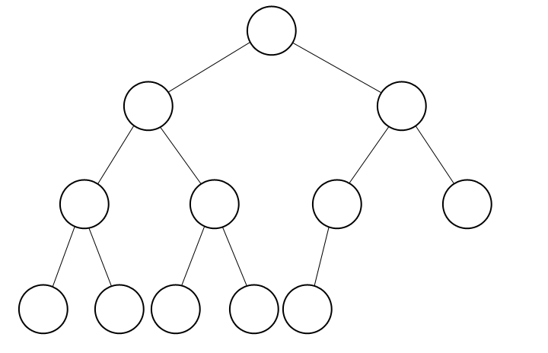
Heap Concept & Application: Priority Queue
HEAP Concept
A heap is a specialized tree-based data structure that satisfies the heap property.
A binary heap is a complete binary tree in which every node satisfies the heap property.
Remember that complete binary tree is a binary tree in which every level, except possibly the last, is completely filled, and all nodes are as far left as possible.

Slide 5
Heap Concept & Application: Priority Queue
Application: Priority Queue
There are many situations, both in real life and in computing applications, where we wish to choose the next “most important” from a collection of people, tasks, or objects.
For example, doctors in a hospital emergency room often choose to see the next “most critical” patient rather than the one who arrived first. When scheduling programs for execution in a multitasking operating system, at any given moment there might be several programs (usually called jobs) ready to run. The next job selected is the one with the highest priority.
Priority is indicated by a particular value associated with the job (and might change while the job remains in the wait list).

Slide 6
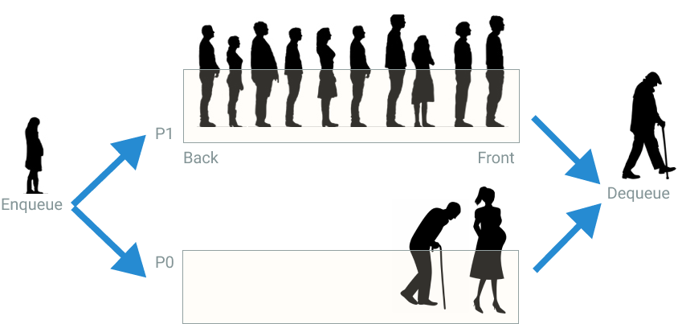
Heap Concept & Application: Priority Queue
Application: Priority Queue

Slide 7
Heap Concept & Application: Priority Queue
Application: Priority Queue
When a collection of objects is organized by importance or priority, we call this a priority queue.
A normal queue data structure will not implement a priority queue efficiently because search for the element with highest priority will take Θ(n) time. A list, whether sorted or not, will also require Θ(n) time for either insertion or removal.
A BST that organizes records by priority could be used, with the total of n inserts and n remove operations requiring Θ(nlogn) time in the average case. However, there is always the possibility that the BST will become unbalanced, leading to bad performance.

Slide 8
Heap Concept & Application: Priority Queue
Application: Priority Queue
Heap is an efficient implementation of priority queue data structure. - find-min : find the smallest element in the heap. - Insert : insert a new element into the heap. - delete-min : delete the smallest element from the heap. delete-min is also called pop, and insert is called push.

Slide 9
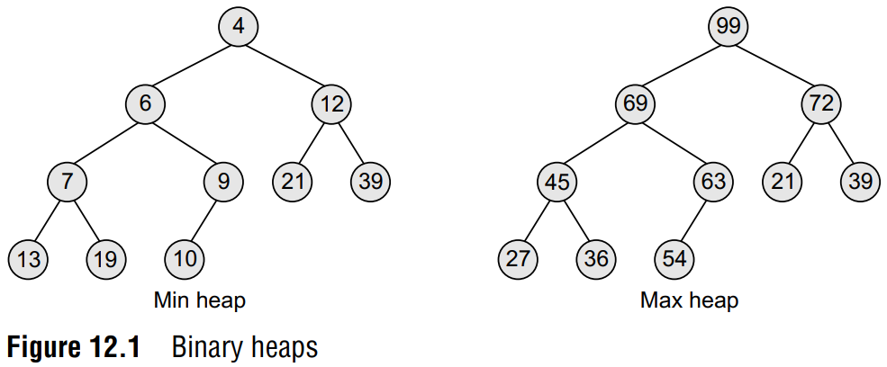
BINARY HEAP Concept
Concept
A binary heap is a complete binary tree in which every node satisfies the heap property.
What kind of heap property? - Min Heap: each node’s element is smaller than its children’s. - Max Heap: each node’s element is larger than its children’s.

Slide 10
BINARY HEAP CONCEPT
Heap Complexity
find-min or find-max : O(1)
insert : O(log(n))
delete-min or delete-max : O(log(n))
Insert and delete-min depend on the tree height, which is log(n), the height of complete binary tree.
Min heaps and max heaps both have their uses. For example, the Heapsort uses the max heap, while the Replacement Selection algorithm used for external sorting uses a min heap.

Slide 11
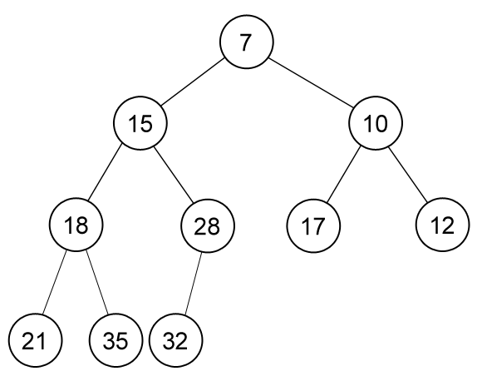
MIN HEAP
Each node’s element is smaller than its children’s element.
It implies that the smallest element is located at the root of the tree.
The largest element is located somewhere at one of the leaves node.
Heap can be implemented using linked-list, but it is much easier to implement heap using array.

Slide 12
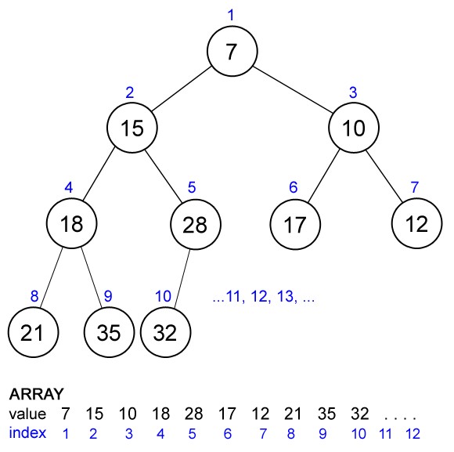
MIN HEAP
Array Implementation
Heaps are usually implemented in an array.
The elements are stored sequentially from index 1 to N from top to bottom and from left to right node of the tree.
Root is stored in index 1 (we let index 0 be blank/unused, for convenience purpose).
Each node relation with its parent left-child and right child in an array implementation can be computed easily.
Let the current node’s index be x. Parent(x) = x / 2 Left-child(x) = 2 * x Right-child(x) = 2 * x + 1 This is why we use index 1 as root, otherwise the relation will not appear as simple as this.
Array Representation

Slide 13
MIN HEAP
Find-Min in Min-Heap
Find-Min in a min-heap is very easy.
Where is the smallest element in a min-heap located? ROOT int findmin() { return data[1]; }

Slide 14
MIN HEAP
Insertion in Min-Heap
We would like to insert a new element into the heap, we should maintain its heap property.
Insert the new element at the end of the heap (after the index of the last element).
Upheap the new element (fixing its heap property).
- Compare current node’s (start with the inserted node) value with its parent’s value. If the current node’s value is smaller than its parent’s than swap their values and continue upheap the parent node.
- Stop if its parent’s value is smaller than current node’s value or current node is the root (has no parent).

Slide 15
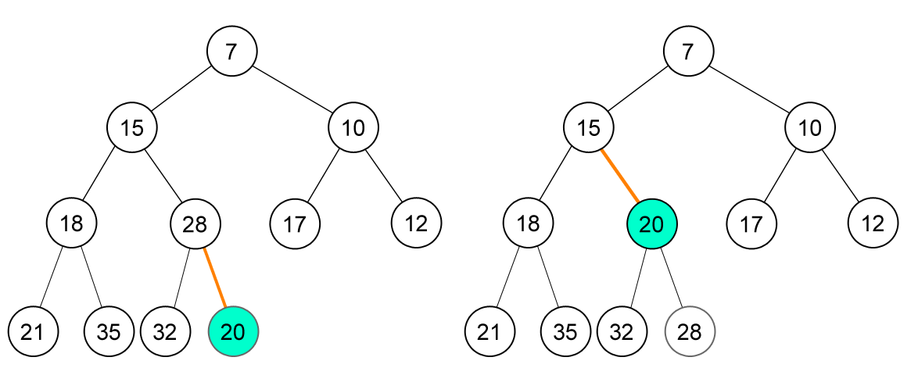
MIN HEAP
Example of Insertion in Min-Heap
Insert new node (20)

Slide 16
MIN HEAP
Example of Insertion in Min-Heap
Insert new node (20)

Slide 17
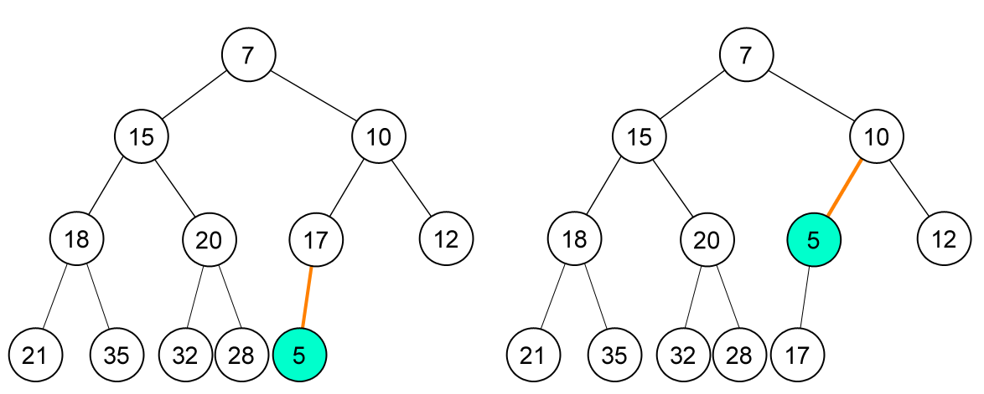
MIN HEAP
Example of Insertion in Min-Heap
Insert new node (5)

Slide 18
MIN HEAP
Example of Insertion in Min-Heap
Insert new node (5)

Slide 19
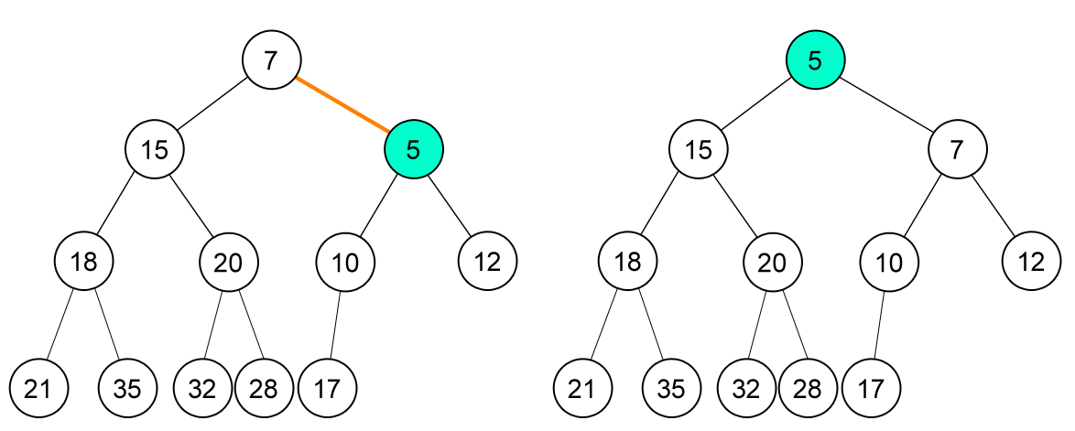
MIN HEAP
Example of Insertion in Min-Heap
Insert new node (5)

Slide 20
MIN HEAP
Example of Insertion in Min-Heap
Insert new node (5)

Slide 21
MIN HEAP
Deletion in Min-Heap
Here, we only concern with deletion of the smallest element which is located at the root.
Replace root with the last element of the heap.
Decrease the number of element in heap.
Downheap root (fixing its heap property).
- Compare current node’s (start with the root) value with its left and right child’s value. Swap current node with its smallest child and continue downheap at that (child) node.
- Stop if current node’s value is smaller than both its children’s value or current node is a leaf (has no child).

Slide 22
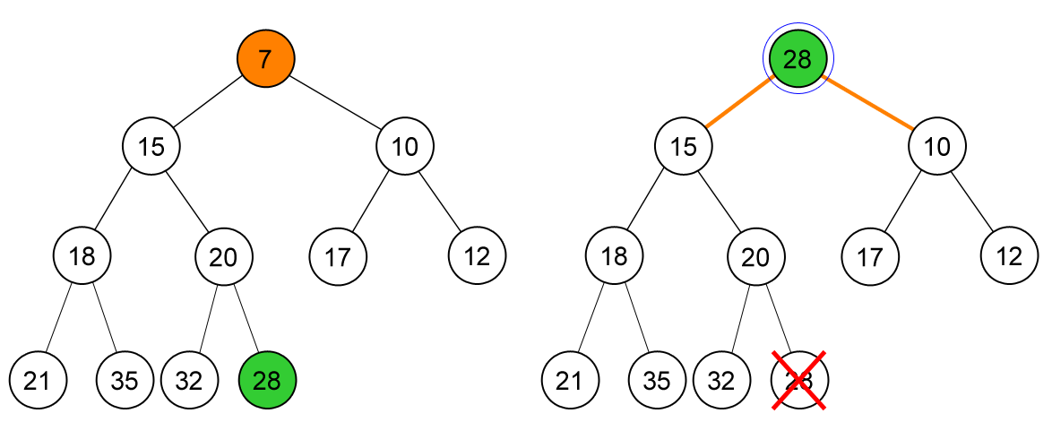
MIN HEAP
Example of Delete-Min in Min-Heap
Delete-min, node (7)
Replace root with the last element, node (28).

Slide 23
MIN HEAP
Example of Delete-Min in Min-Heap
Delete-min, node (7)
Replace root with the last element, node (28).

Slide 24
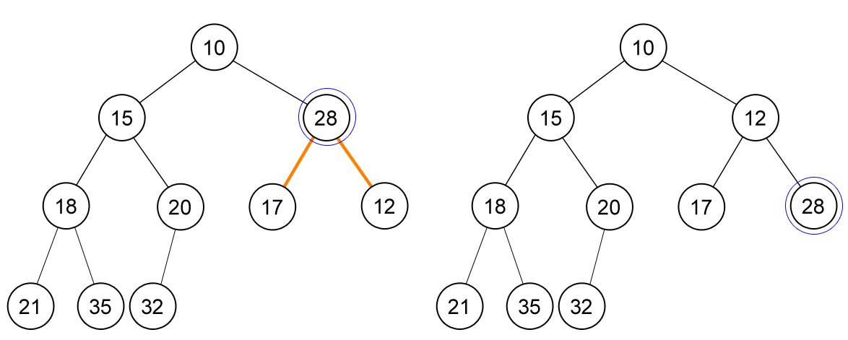
MIN HEAP
Example of Delete-Min in Min-Heap
Delete-min, node (7)
Replace root with the last element, node (28).

Slide 25
MIN HEAP
Example of Delete-Min in Min-Heap
Delete-min, node (7)
Replace root with the last element, node (28).

Slide 26
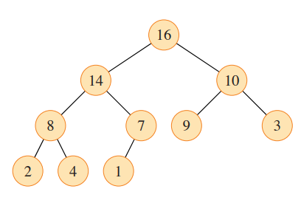
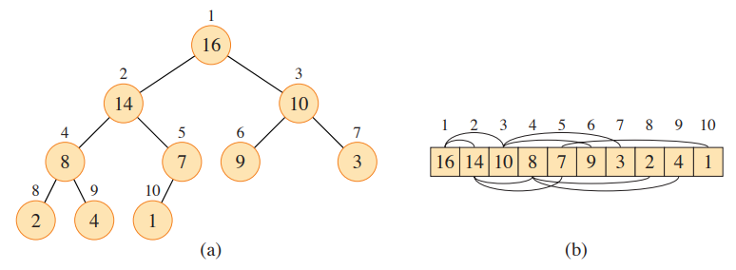
MAX HEAP
Each node’s element is larger than its children’s element. It implies that the largest element is located at the root of the tree.
Max-heap holds the same principle as min-heap and can be used to create priority queue which need to find the largest element instead of the smallest one.
The number within the circle at each node in the tree is the value stored at that node.
The number above a node is the corresponding index in the array.
Above and below the array are lines showing parent-child relationships,
with parents always to the left of their children.

Slide 27
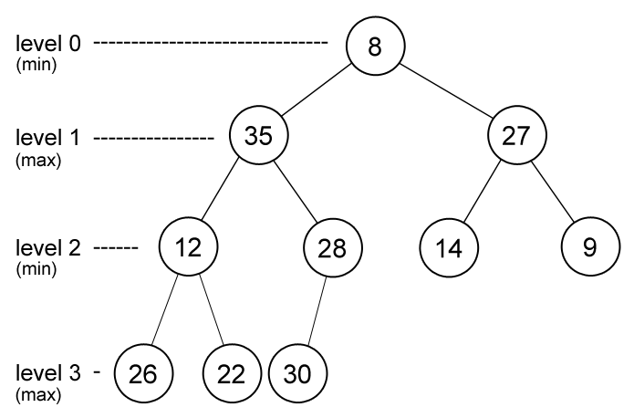
Min-Max Heap
Concept
The heap condition alternates between minimum and maximum level to level
Each element on even/odd level are smaller than all its children (min-level).
Each element on odd/even level are larger than all its children (max-level).
The purpose of min-max heap is to allow us to find both the smallest and the largest element of the heap at the same time.

Slide 28
Min-Max Heap
Concept
In min-max heap,
- The smallest element is located at the root.
- The largest element is located in one of the root’s child (either left/right child).
Note: the largest element may be located at root if there is only one element in the heap.
findmin() { return data[1]; }
findmax() { return max(data[2], data[3]); }

Slide 29
Min-Max Heap
Insertion in Min-Max Heap
Insert the new element at the end of the heap after the index of the last element).
Upheap the new element (fixing its heap property).
Upheap in min-max heap is a bit different with min-heap or max-heap.
If the new node is on a min-level - If new node’s parent is smaller than it then swap their value and upheapmax from its parent. - Else upheapmin from the new node
If the new node is on a max-level - If new node’s parent is larger than it then swap their value and upheapmin from its parent. - Else upheapmax from the new node

Slide 30
Min-Max Heap
Insertion in Min-Max Heap
Upheapmin Compare current node’s value with its grand-parent’s value. If the current node’s value is smaller than its parent’s then swap their values and continue upheapmin the grand-parent node.
Upheapmax Compare current node’s value with its grand-parent’s value. If the current node’s value is larger than its parent’s then swap their values and continue upheapmax the grand-parent node.

Slide 31
Min-Max Heap
EXAMPLE (Insert 50)
8
35
27
12
28
14
9
26
22
30

Slide 32
Min-Max Heap
EXAMPLE (Insert 50)
8
35
27
12
28
14
9
26
22
30
50
Upheapmin : 50 is larger than its parent, so do upheapmax
Upheapmax : 50 is larger than its grand-parent, so swap their value

Slide 33
Min-Max Heap
EXAMPLE (Insert 50)
8
50
27
12
28
14
9
26
22
30
35
Upheapmax : because node 50 doesn’t have grand-parent, the process is finished

Slide 34
Min-Max Heap
EXAMPLE (Insert 5)
8
50
27
12
28
14
9
26
22
30
35
5
Upheapmin : node 5 is smaller than its parent, so swap their value and continue upheapmin

Slide 35
Min-Max Heap
EXAMPLE (Insert 5)
8
50
27
12
28
5
9
26
22
30
35
14
Upheapmin : node 5 is smaller than its grand-parent, so swap their value and continue upheapmin

Slide 36
Min-Max Heap
EXAMPLE (Insert 5)
5
50
27
12
28
8
9
26
22
30
35
14
Upheapmin : because node 5 doesn’t have grand-parent, the process is finished

Slide 37
Min-Max Heap
Deletion in Min-Max Heap
Deletion of the smallest element
Replace root with the last element in heap.
Decrease the number of element in heap.
Downheapmin from root.
Deletion of the largest element
Replace either left-child or right child of root (depends on which one is larger) with the last element in heap.
Decrease the number of element in heap.
Downheapmax from the node.

Slide 38
Min-Max Heap
Deletion in Min-Max Heap
Downheapmin
Let m is the smallest element in current node’s children and grandchildren (if any).
If m is grandchildren of current node then
If m is smaller than current node then
Swap their value
If m is larger than its parent then swap their value
Continue downheapmin from m
If m is children of current node then
If m is smaller than current node then
Swap their value
Downheapmax is the same except that the relational operators are reversed.

Slide 39
Min-Max Heap
EXAMPLE (Delete Max)
5
50
27
12
28
8
9
26
22
30
35
14
Replace the max value and replace it with last node (14)

Slide 40
Min-Max Heap
EXAMPLE (Delete Max)
5
14
27
12
28
8
9
26
22
30
35
Downheapmax : find the largest value from its children and grand-children. After that, swap their value.

Slide 41
Min-Max Heap
EXAMPLE (Delete Max)
5
35
27
12
28
8
9
26
22
30
14
Downheapmax : because 14 parents is larger than 14, swap their value and continue downheapmax.

Slide 42
Min-Max Heap
EXAMPLE (Delete Max)
5
35
27
12
14
8
9
26
22
30
28
Because 28 doesn’t have children or grand-children, the process is finished

Slide 43
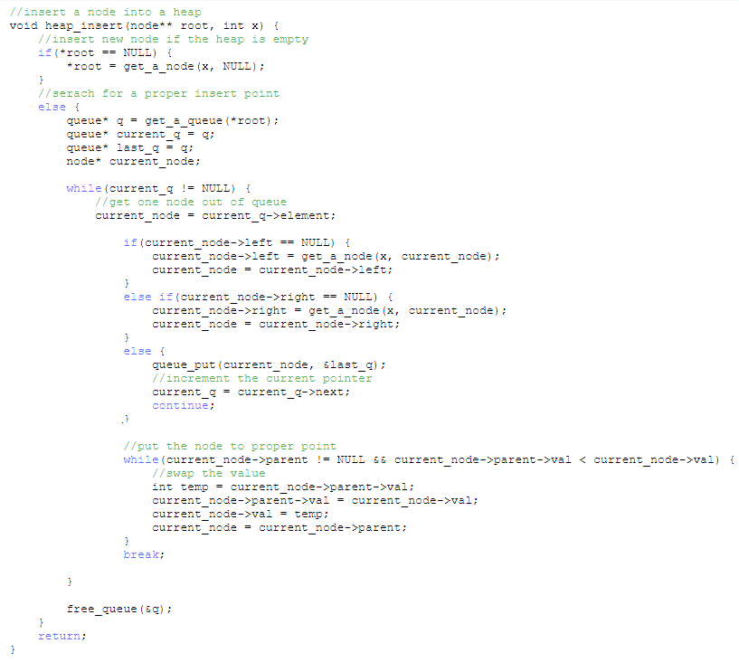
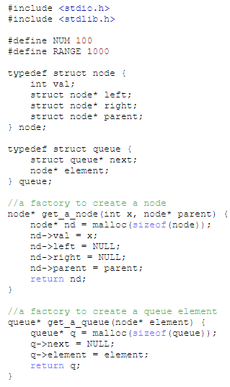
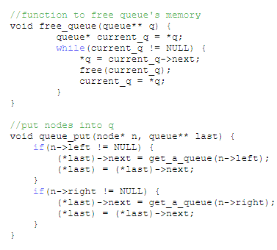
Program Example using Linked List
Heaps -- Linked-list Implementation

Slide 44
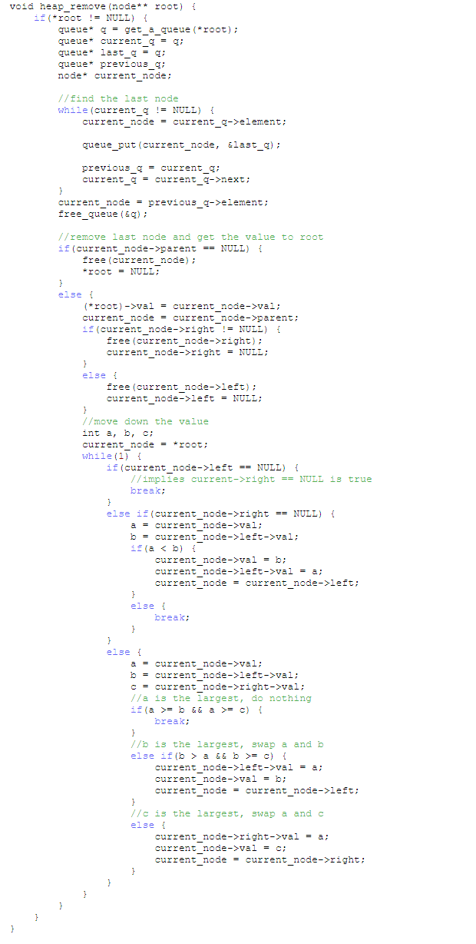
Program Example using Linked List
Heaps -- Linked-list Implementation
Notes:
Heaps -- Linked-list Implementation

Slide 45
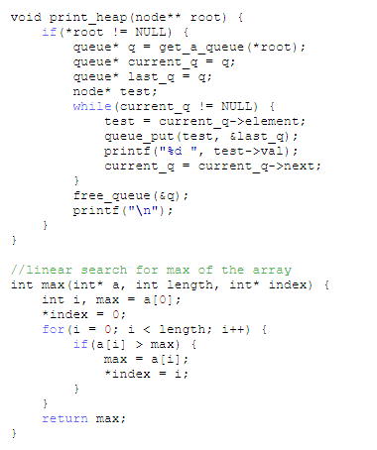
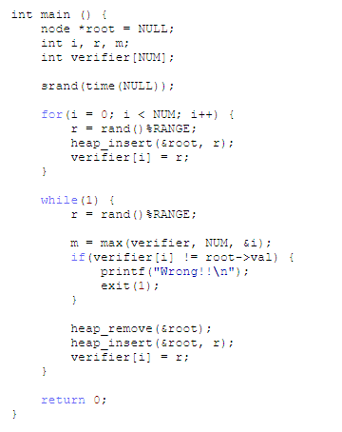
Program Example using Linked List
Heaps -- Linked-list Implementation
Notes:
Heaps -- Linked-list Implementation

Slide 46
References
S. Sridhar. 2015. Design and Analysis of Algorithms. Oxford University Press. New Delhi. ISBN: 9780198093695. Chapter 6
Reema Thareja. 2014. Data structures using C. Oxford University Press. New Delhi. ISBN:9780198099307. Chapter 11 & 12
Thomas H. Cormen, Charles E. Leiserson, Ronald L. Rivest, & Clifford Stein. (2009). Introduction to Algorithms. 03. The MIT Press. London. ISBN: 9780262033848. Chapter 6
Heap, https://visualgo.net/en/heap?slide=1
https://opendsa-server.cs.vt.edu/ODSA/Books/Everything/html/Heaps.html
http://tsao.wikidot.com/heap-explicit-implementation

